Slide 1

Threads
CCS0023/L
Object Oriented Programming (Java)

Slide 2
14
LESSON #14
Threads
Threads

Slide 3
Objectives:
To determine the useful of threads and what threads are
To know how threads enable to manage concurrent activities
To know the life cycle of thread
To apply thread synchronization in program
To know what producer/consumer relationships are and how they’re implemented with multithreading
To enable multiple threads to update Swing GUI components in a thread-safe manner

Slide 4
Threads
Concurrent Programming
Are light-weight processes within a process
Threads allow you to write concurrent operations in an OS-independent way.
In C/C++, each OS has its own thread API. In C/C++, each OS has its own thread API. You have to write different code for each OS.
Note that only the code stays the same. The actual behavior of the threading is different for each OS.

Slide 5
Threads improve user experience
Single-user applications can return control to the user while performing a long-running operation.
Multi-user applications allow for multiple-users to use the system without have to wait for each other to finish.

Slide 6
Single-threaded Process
Multiple threaded Process
Threads of
Execution
Single instruction stream
Multiple instruction stream
Common
Address Space

Slide 7
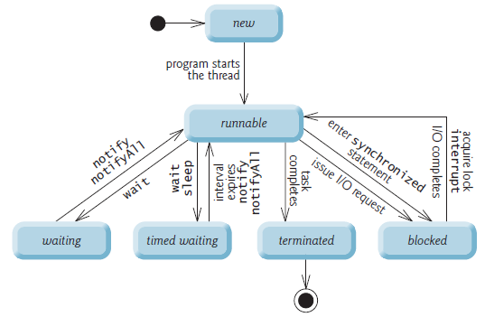
Thread States
Thread life-cycle UML state diagram

Slide 8
New and Runnable States
A new thread begins its life cycle in the new state. It remains in this state until the program starts the thread, which places it in the runnable state. A thread in the runnable state is considered to be executing its task.
Waiting State
Sometimes a runnable thread transitions to the waiting state while it waits for another thread to perform a task. A waiting thread transitions back to the runnable state only when another thread notifies it to continue executing.

Slide 9
Timed Waiting State
A runnable thread can enter the timed waiting state for a specified interval of time. It transitions back to the runnable state when that time interval expires or when the event it’s waiting for occurs. Timed waiting and waiting threads cannot use a processor, even if one is available.
Blocked State
A runnable thread transitions to the blocked state when it attempts to perform a task that cannot be completed immediately and it must temporarily wait until that task completes.

Slide 10
Terminated State
A runnable thread enters the terminated state (sometimes called the dead state) when it
successfully completes its task or otherwise terminates (perhaps due to an error).

Slide 11
Java has built in thread support for Multithreading
Synchronization
Thread Scheduling
Inter-Thread Communication:
currentThread start setPriority
yield run getPriority
sleep stop suspend
resume
Java Garbage Collector is a low-priority thread

Slide 12
new
wait()
sleep()
suspend()
blocked
start()
runnable
non-runnable
notify()
slept
resume()
unblocked
stop()
dead

Slide 13
Create a class that extends the Thread class
Create a class that implements the Runnable interface

Slide 14
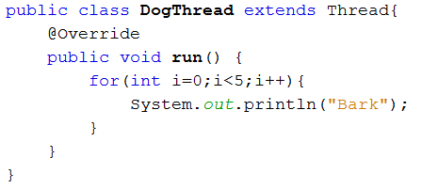
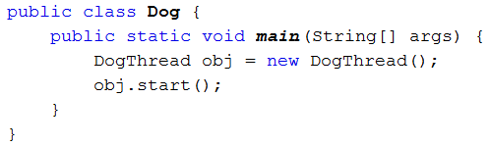
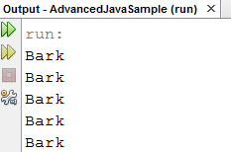
Creating Threads
Extend Thread
Implement Runnable
Extend Thread

Slide 15
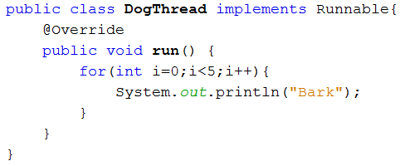
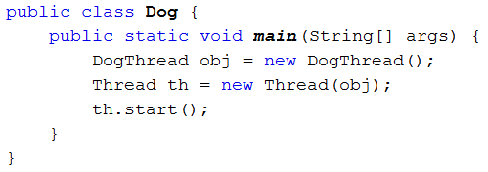
Implement Runnable
You can’t restart a dead thread
Once the run() method has exited, the thread dies

Slide 16
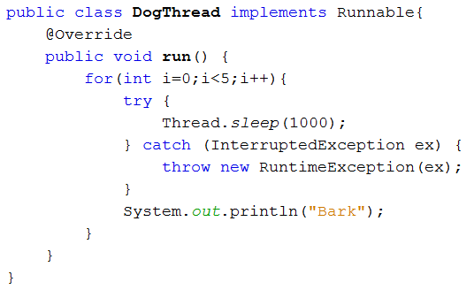
Sleep() Method
Tells the thread to stop operating for at least the number of milliseconds of the parameter.

Slide 17
Creating and Executing Threads with Executor Framework
Creating Concurrent Tasks with the Runnable Interface
You implement the Runnable interface (of package java.lang) to specify a task that can execute concurrently with other tasks. The Runnable interface declares the single method run, which contains the code that defines the task that a Runnable object should perform.

Slide 18
Executing Runnable Objects with an Executor
To allow a Runnable to perform its task, you must execute it. An Executor object executes Runnables. An Executor does this by creating and managing a group of threads called a thread pool. When an Executor begins executing a Runnable, the Executor calls the Runnable object’s run method, which executes in the new thread.
The Executor interface declares a single method named execute which accepts a Runnable as an argument.
Using an Executor has many advantages over creating threads yourself. Executors can reuse existing threads to eliminate the overhead of creating a new thread for each task and can improve performance by optimizing the number of threads to ensure that the processor stays busy, without creating so many threads that the application runs out of resources.

Slide 19
Using Class Executors to Obtain an ExecutorService
The ExecutorService interface (of package java.util.concurrent) extends Executor and declares various methods for managing the life cycle of an Executor. An object that implements the ExecutorService interface can be created using static methods declared in class Executors (of package java.util.concurrent).
Implementing the Runnable Interface

Slide 20
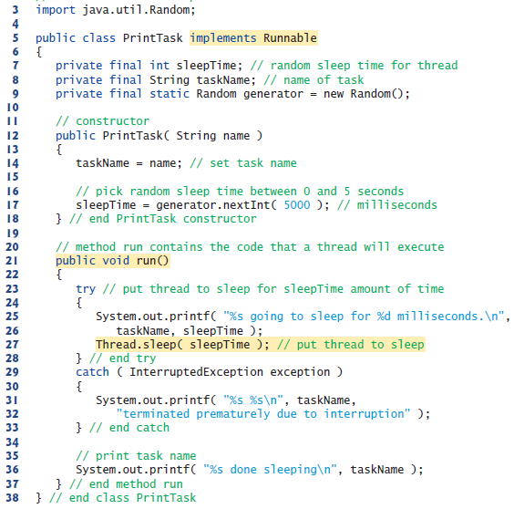

Slide 21
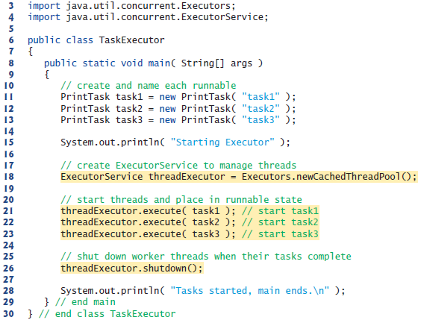

Slide 22
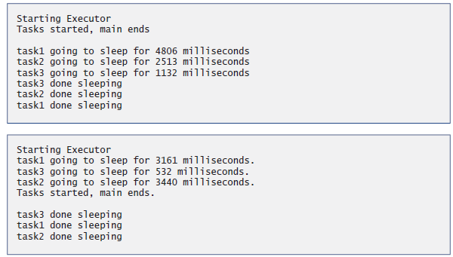

Slide 23
Thread Synchronization
coordinates access to shared data by multiple concurrent threads.
by synchronizing threads in this manner, you can ensure that each thread accessing a shared object excludes all other threads from doing so simultaneously—this is called mutual exclusion.
all the other threads attempting to enter a synchronized statement on the same object are placed in the blocked state.

Slide 24
Synchronization
Most business applications are more concerned with synchronization than direct handling of threads.
When you synchronize on some code, a thread needs to obtain a “lock” on an object in order for to run the code.
Therefore, only one thread at a time will run the selected code.
We used the synchronized keyword.

Slide 25
class MyThread implements Runnable {
Shared so;
public MyThread (Shared s) { so = s;}
public void run() { so.method1(); }
} // end class MyThread
class YourThread implements Runnable {
Shared so;
public YourThread (Shared s) { so = s; }
public void run() { so.method2(); }
} // end class YourThread
class HerThread implements Runnable {
Shared so;
public HerThread (Shared s) { so = s; }
public void run() {so.method3(); }
} // end class HerThread

Slide 26
class Shared { // the 'monitor'
// if 'synchronized' is removed, the outcome is unpredictable
public synchronized void method1( ) {
for (int i = 0; i < 200; i++) { System.out.print(" [1] :: " + i ) ; }
}
// if the 'synchronized' is removed, the outcome is unpredictable
public synchronized void method2( ) {
for (int i = 0; i < 200; i++) { System.out.print(" [2] :: " + i ) ; }
}
// if the 'synchronized' is removed, the outcome is unpredictable
public synchronized void method3( ) {
for (int i = 0; i < 200; i++) { System.out.print(" [3] :: " + i ) ; }
}
} // end class Shared

Slide 27
class MyMainClass {
public static void main(String [] args ) {
Shared sharedObject = new Shared ();
Thread t1 = new Thread(new MyThread(sharedObject));
Thread t2 = new Thread(new YourThread(sharedObject));
Thread t3 = new Thread(new HerThread(sharedObject));
t1.start();
t2.start();
t3.start();
} // end main()
} // end class ThreadEx5

Slide 28
Synchronization Issues
Too much synchronization can cause bottlenecks if in a heavily multi-threaded applications
Not enough synchronization can lead to data inconsistency and corruption.

